Slide 1
Topic 5.1
Clustering Analysis
(Chapter 4: Data Mining and Data Warehousing textbook)

Slide 2
Topics 5.1
What is Cluster Analysis?
Purpose of Cluster Analysis.
Explain 2 types of clustering techniques.
Explain k-means clustering technique.
How does k-means clustering technique work?
Purpose of scaling & weightage
When do you use Clustering Technique.
Advantages of Clustering Technique.
Disadvantages of Clustering Technique.

Slide 3
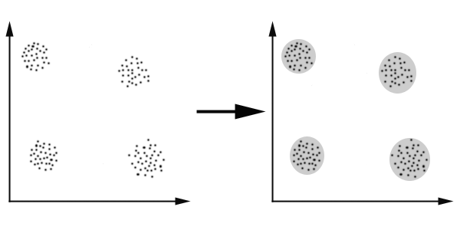
What Is Cluster Analysis?
Clustering is the assignment of data objects (records) into groups (called clusters) so that data objects from the same cluster are more similar to each other than objects from different clusters . http://en.wikipedia.org/wiki/Data_clustering

Slide 4
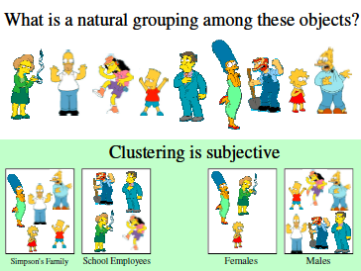
Cluster Analysis Concepts
Clustering is to organise data into clusters such that there is natural groupings among objects.

Slide 5
Cont. Cluster Analysis Concepts
The aim is to group records into disjoint classes that are similar with regards to inputs
  Records in the same cluster are similar
  Records in different cluster are dissimilar
It is considered as Undirected data mining style or unsupervised classification. Unsupervised because clusters are discovered in the mining process.

Slide 6
Why do we want to organise data into clusters?
Purpose of clustering: When data are being organised into clusters, they show the internal structure of the data
– e.g. Clustering genes
– e.g. Market segmentation
– e.g. Underlying rules, reoccurring patterns & etc.

Slide 7
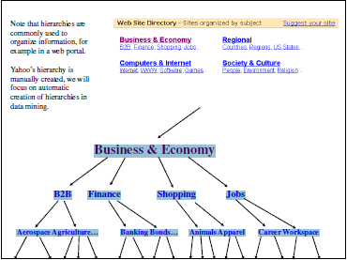
Another example of application: Yahoo’s Hierarchies

Slide 8
Examples of REAL Applications
Marketing: finding groups of customers with similar behavior given a large database of customer data containing their properties and past buying records;
Biology: classification of plants and animals given their features;
Libraries: book ordering;
Insurance: identifying groups of motor insurance policy holders with a high average claim cost; identifying frauds;
City-planning: identifying groups of houses according to their house type, value and geographical location;
Earthquake studies: clustering observed earthquake epicenters to identify dangerous zones;
WWW: document classification; clustering weblog data to discover groups of similar access patterns.

Slide 9
Commonly used Cluster Algorithms
Partitional algorithms
    - K-means
Hierarchical algorithms

Slide 10
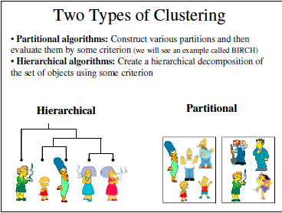

Slide 11
Properties of a Clustering Algorithm
Scalability (in terms on both time and space)
Ability to deal with different data types
Minimal requirements for domain knowledge to determine input parameters
Able to deal with noise and outliers
Insensitive to order of input records
Incorporation of user-specified constraints
Interpretability and usability

Slide 12
Partitional Algorithms (K-Means)
Non-hierarchical, each instance is placed in exactly one of K non-overlapping clusters.
Since only one set of clusters is output, the user normally has to input the desired number of clusters K.

Slide 13
How does k-means cluster analysis work?
Specify the number of clusters k.
Choose k initial cluster seeds.
Assign cases closest to seed j as belonging to cluster j; j = 1…, k.
Calculate the mean of the cases/records in each cluster

Slide 14
How does k-means cluster analysis work?
Reassign cases closest to the new seed j as belonging to cluster j.
Take the mean of the cases in each cluster as the new cluster seed.
Iterate until convergence

Slide 15
How to determine the no. of clusters?
The number of segments/clusters is determined
  By the business problem (eg if we focus on 4 customer groups, then there will be 4 clusters)
An iterative process is employed to determine the most useful segment/cluster

Slide 16
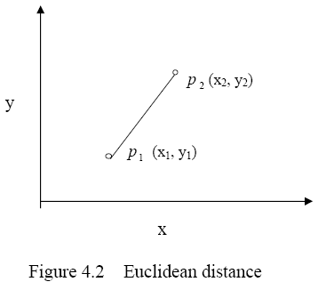
K-means cluster analysis uses Euclidean distance
Euclidean distance is the measure of similarity (pg 52)
A straight-line distance
between two points
Formula ____________

Slide 17
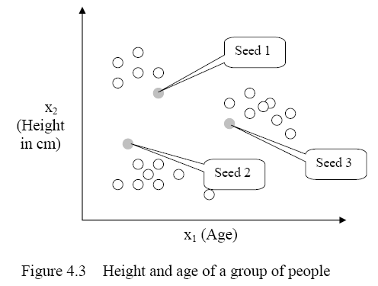
How K-means clustering works?
K=3
Choose 3 seeds
Assign records to
the nearest seed
But how?

Slide 18
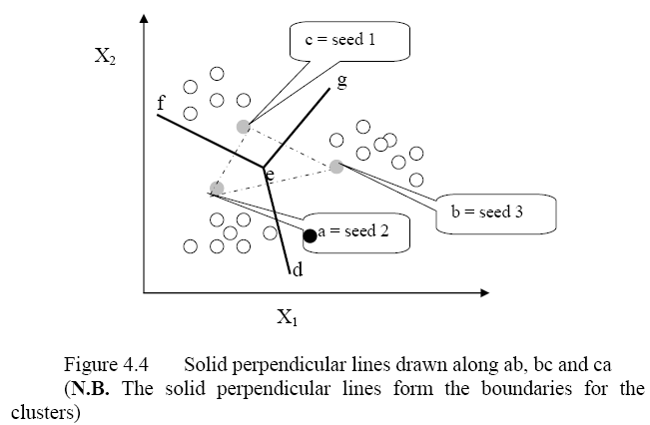
How to assign records to the nearest seed?
Draw a dotted line between b & c
Draw a line
Perpendicular
To Line bc
Repeat for
ab and bc

Slide 19
After this iteration, find new mean (centroid ) for each new cluster
+
+
+
+

Slide 20
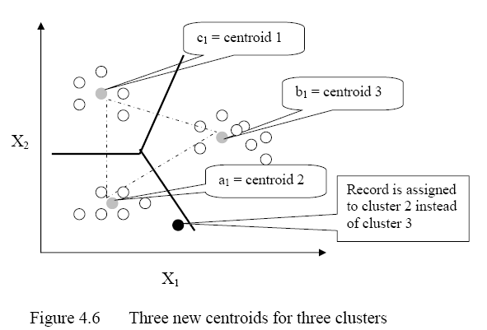
In the next iteration, use the new centroids, assign records to nearest centroid to form new cluster again
+
Reiterate until
Convergence:
Perpendicular
Lines do not
shift for
subsequent
Iterations.
+
+
+

Slide 21
Summary of K-Means
Strength
– Simple, easy to implement and debug
– Intuitive objective function: optimizes intra-cluster similarity
– Relatively efficient: O(tkn), where n is # objects, k is # clusters,
and t is # iterations. Normally, k, t << n.
• Weakness
– Applicable only when mean is defined, then what about categorical data?
– Often terminates at a local optimum. Initialization is important.
– Need to specify K, the number of clusters, in advance
– Unable to handle noisy data and outliers
– Not suitable to discover clusters with non-convex shapes
• Summary
– Assign members based on current centers
– Re-estimate centers based on current assignment

Slide 22
Why is there a need to scaled an input variable?
The input means are normalized using a scale transformation function
Why is an input variable normalized or scaled?
  It is required when different variables are measured in different units of measurements. For example, distance is measured by kilometres and by miles.

Slide 23
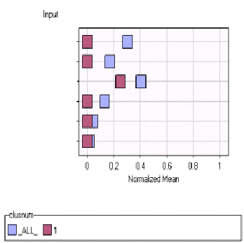
Importance of Normalizing / Scaling
Does not make sense to compare
  X vs Y
  #properties vs income
Why?
  Measured in Different unit
So How?
  Map to a common range
    0 to 1 or
    -1 to 1
X mile
Y km
#properties
Income
At least the ratio of
change becomes comparable

Slide 24
Scaling Method 1
Cust Id | C001 | C002 | C003
Number of properties | 2 | 1 | 3
Salary per mth($) | 11000 | 5000 | 20000

Slide 25
Scaling Method 1 divide by mean
Mean of Number of Properties = 2
Mean of Salary = 12000
Cust Id | C001 | C002 | C003
Scaled #properties | 2/2=1 | ½=0.5 | 3/2=1.5
Scaled Salary/mth($) | 11000/12000 = 0.916 | 5000/12000 =0.416 | 20000/12000 =1.66

Slide 26
Scaling Method 2
For each variable, subtract the lowest value
Next divide each variable by the range
  (highest value minus lowest value)
For this method, variable scaled to between 0 and 1

Slide 27
Scaling Method 2 minus lowest, divide by range
#properties: lowest = 1, range = 3-1=2
Salary: lowest= 5000, range= 20000-5000=15000
Cust Id | C001 | C002 | C003
Scaled #properties | 0.5 | 0 | 1
Scaled Salary/mth($) | 0.4 | 0 | 1

Slide 28
Weightage
Attach more importance to one variable compared with another
Y = a₁X₁ + a₂X₂
  = 10 X₁ + X₂
  Implies that X₁ is 10 times more important than X₂

Slide 29
Clustering Methods: Comparison
 | Hierarchical | K-means
Assumptions | Requires a similarity/distance measure | Requires strong assumptions
Input Parameters | None | K (number of clusters)
Clusters | Subjective(only a tree is returned) | Exactly K clusters

Slide 30
When do you use cluster analysis?
(pg 63)
For large, complex data set
  with many variables and
  there are natural groupings that may represent groups of customer’s similar properties.
a) Prelude to any data mining or analysis
  Cluster customers into smaller, simpler segments and analyse each segment separately.
  Once interesting clusters are found, other data mining techniques such as Decision Tree and Neural Network Techniques have better chance of discovering rules and patterns.

Slide 31
When do you use cluster analysis?
(pg 63)
b) As a classification scheme
  May label each cluster with a class label
    e.g. defaulter on loan/repaid
    e.g. Good/average students
c) Give insight into a problem
  to discover structure in the dataset
    Group similar products together
  to generate hypotheses (hypotheses are ideas that are based on known facts and are used as basis for reasoning or further investigation).

Slide 32
Disadvantages of cluster analysis(pg 64)
Difficult to choose the right number of clusters
Different clustering methods such as k-means and self-organising maps generate different solutions to the same data set
The resulting clusters may be sub-optimal. This may be due to poor starting partition of the data set
It is difficult to interpret the resulting clusters

Slide 33
Advantages of cluster analysis (pg 64)
It works well with categorical, numeric and textual data
It is easy to find clusters of customers as in point-of-sales data.
It can be used to uncover hidden patterns in a data set that can be used to improve the performance of directed techniques.

